Slide 1
Jing Di; Shuai Ma; Jing Lian; Guodong Wang
A U-Net Network Model for Medical Image Segmentation Based on Improved Skip Connections
이스마일
2022

Slide 2
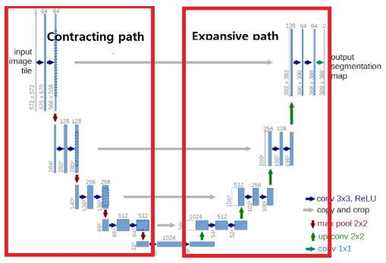
The key finding or Contribution of this paper
To address the loss problem Introduced by downsampling in the classical U-Net Architecture , This paper Improves U-Net model and use the model for Image Segmentation
This paper still is using the classical U-net Encoder -Decoder Network in which the encoder and decoder networks are connected by skip connections
In Classical U-Net , the points are only three lines downsampling encoding , upsampling decoding and skip connections .Among them downsampling performs information compression and upsampling performs pixel recovery .

Slide 3
The key finding or Contribution of this paper
As can be seen from the diagram , U-Net performs 4 times of maximum pooling downsampling , uses convolution for information extraction after each sampling to get feature map and then goes through 4 times of upsampling to recover the input pixel size
The most critical and unique part of U-Net is the skip connection that connects the up-sampling and down- sampling parts of the graph, and each downsampling has a skip connection with the corresponding up-sampling for concatenating

Slide 4
The key finding or Contribution of this paper
The paper considers two questions
Why U-Net Structure apply two convolutional layers before concatenating the feature maps in the skip connections ?
and also can concatenating operation be applied to other parts of the network architecture besides the skip connection?
This become the goal of the study and research of this paper

Slide 5
Classic U-Net :Skip Connections
The classical U-Net structure the downsampling part is mainly composed of convolutional blocks containing two convolutions and maximum pooling , Theoretically , multiple downsampling can me the model to learn deeper image information but this can cause loss of underlying information as Geoffrey Hinton talks about capsule networks project at MIT .

Slide 6
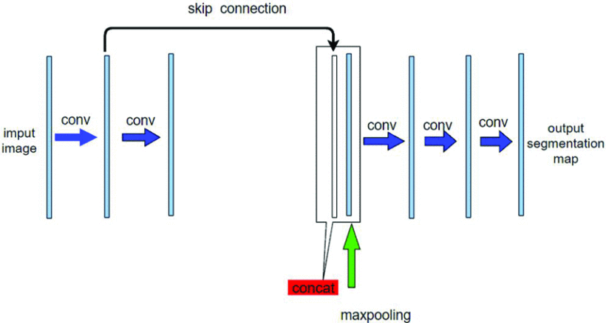
Skip Connections Improvement
The first improvement point takes the input and output layers as an example, where the input image is convolved once with the output layer's result from upsampling in the channel dimension by skip connection

Slide 7
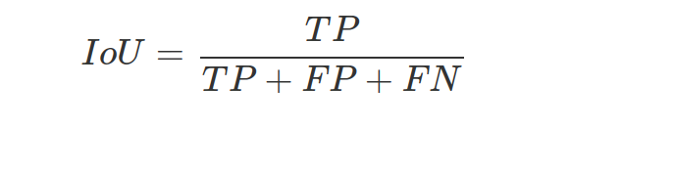
Evaluation Metrics
The evaluation metrics used in the experiment are mIoU, Aver_dice, and Loss.
The mIoU is defined as the intersection of the predicted and actual regions for each class divided by the concatenated set IoU of the predicted and actual regions, summed and then averaged, and the IoU formula is defined as

Slide 8
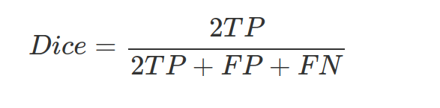
Evaluation Metrics
The evaluation metrics used in the experiment are mIoU, Aver_dice, and Loss.
The mIoU is defined as the intersection of the predicted and actual regions for each class divided by the concatenated set IoU of the predicted and actual regions, summed and then averaged, and the IoU formula is defined as
Aver_dice is defined as the intersection of twice divided by the pixel sum, summed and then averaged. The formula is defined as
Loss is the cross-entropy loss function commonly used in pytorch

Slide 9
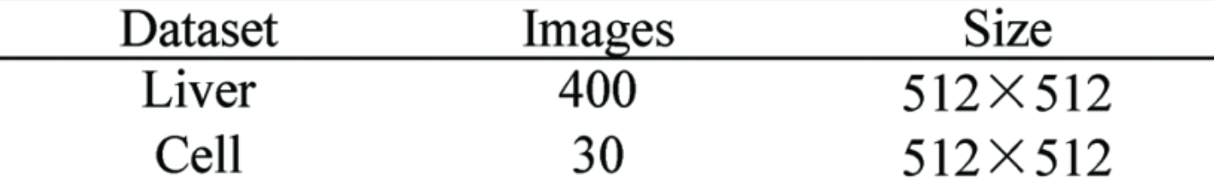
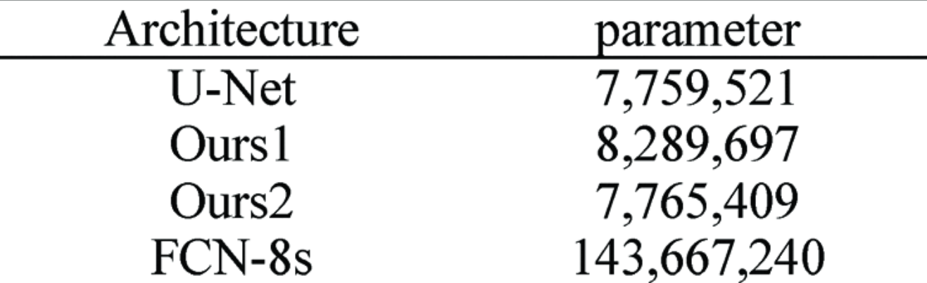
Experimental Results
The public medical image dataset used for the experiments is shown
In order to verify the effectiveness of the improvements in this paper, the classical U-Net and the improved U-Net and FCN-8s [10] (VGG16) in this paper are used for a comparative study, and the number of parameters of each model is shown.
From the table, it is known that the two models Ours1 and Ours2 improved in this paper have slightly higher number of parameters than classical U-Net

Slide 10
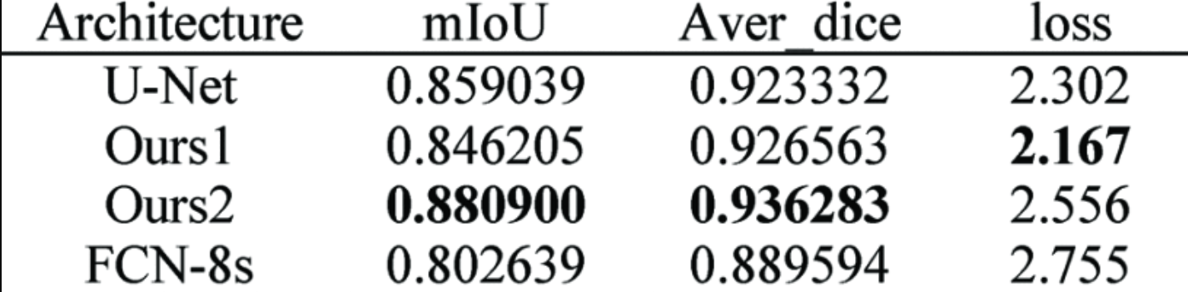
Experimental Results
The models are tested and compared on the liver dataset with the experimental parameters epoch set to 32 and batch_size set to 1.
From the data in the table, we can see that the improvements in this paper effectively improve the segmentation effect. Ours1, the model with improved skip connection suggested in this paper, achieves the highest mIoU and Aver_dice values, and Ours2, the model with improved skip connection and convolutional blocks, is second only to Ours1 and has the smallest loss value, which indicates that the two improvements in this paper do have an optimization effect on liver segmentation.

Slide 11
Key point that i can take from this paper
Applying Convolutional layers before concatenation : As the paper suggest applying one convolutional layer before concatenating the feature maps in the skip connections will improve the fusion of high and low level information - So in this case may be my latent vector can contain information about the segmented image and reconstructed image .

